Slide 1

W4111 – 02: Introduction to Databases
Lecture 7: ER Modeling, SQL, Relational Closure (for now)
Donald F. Ferguson dff9@Columbia.edu
TRANSCENDING DISCIPLINES, TRANSFORMING LIVES

Slide 2

We will start in a a couple of minutes.
2 | W4111_02_F20: Introduction to Databases -- Lecture 7

Slide 3
Today’s Agenda
3 | W4111_02_F20: Introduction to Databases – Lecture 7

Slide 4
Today’s Agenda
Questions/answers.
Some final topics in Relational Model, SQL, ER Modeling.
Additional operators (from RelaX site).
Weak Entity
IsA, Inheritance
Redundant Attributes
Aggregation
ER/RDB design patterns and practices.
DB Applications
Web applications, Jupyter notebooks
Connection, cursors
SQL Injection
Some worked examples – Or, Prof. Ferguson lets you watch him write code to make you feel better.
Inheritance
Cleaning up addresses
4 | W4111_02_F20: Introduction to Databases – Lecture 7

Slide 5
Questions, Answers, Discussion
5 | W4111_02_F20: Introduction to Databases -- Lecture 7
Notes:
bb

Slide 6
NULL – Complex SQL Question and Codd’s 3rd Rule
6 | W4111_02_F20: Introduction to Databases – Lecture 7

Slide 7
ER Model, Relation Model, SQL Closure (for now)
7 | W4111_02_F20: Introduction to Databases -- Lecture 7
Notes:
bb

Slide 8

Weak Entity Sets
8 | W4111_02_F20: Introduction to Databases -- Lecture 6

Slide 9
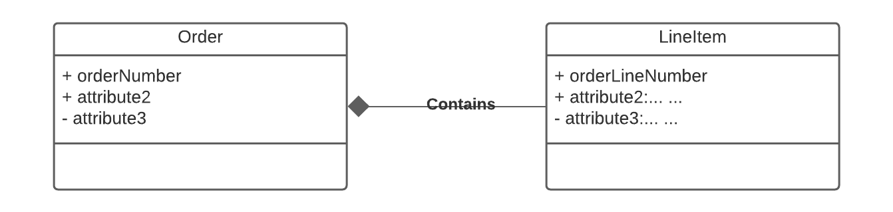
Example Order Form – Order “Contains” Line Items
Customer ID: 201
OrderNo: 31
OrderedDate:504
Containment is a common concept in data models.
Containment implementation is common in object-oriented models.
Domains are atomic in the relational model → Lists/Arrays are not possible.
Weak Entity is one way to model.
ProductID | Quantity | Price | OrderID
111 | 2 | 2.10 | 31
101 | 11 | 1.30 | 31
333 | 102 | 47.5 | 31
public class LineItem { }
public class Order { }
LineItem lineItem[];
9 | W4111_02_F20: Introduction to Databases – Lecture 6

Slide 10
Weak Entity Sets
Consider a section entity, which is uniquely identified by a course_id, semester, year, and sec_id.
Clearly, section entities are related to course entities. Suppose we create a relationship set sec_course between entity sets section and course.
Note that the information in sec_course is redundant, since section already has an attribute course_id, which identifies the course with which the section is related.
One option to deal with this redundancy is to get rid of the relationship sec_course; however, by doing so the relationship between section and course becomes implicit in an attribute, which is not desirable.

Slide 11
Weak Entity Sets (Cont.)
An alternative way to deal with this redundancy is to not store the attribute course_id in the section entity and to only store the remaining attributes section_id, year, and semester.
However, the entity set section then does not have enough attributes to identify a particular section entity uniquely
To deal with this problem, we treat the relationship sec_course as a special relationship that provides extra information, in this case, the course_id, required to identify section entities uniquely.
A weak entity set is one whose existence is dependent on another entity, called its identifying entity
Instead of associating a primary key with a weak entity, we use the identifying entity, along with extra attributes called discriminator to uniquely identify a weak entity.

Slide 12
Weak Entity Sets (Cont.)
An entity set that is not a weak entity set is termed a strong entity set.
Every weak entity must be associated with an identifying entity; that is, the weak entity set is said to be existence dependent on the identifying entity set.
The identifying entity set is said to own the weak entity set that it identifies.
The relationship associating the weak entity set with the identifying entity set is called the identifying relationship.
Note that the relational schema we eventually create from the entity set section does have the attribute course_id, for reasons that will become clear later, even though we have dropped the attribute course_id from the entity set section.

Slide 13
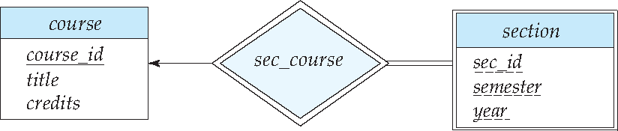
Expressing Weak Entity Sets
In E-R diagrams, a weak entity set is depicted via a double rectangle.
We underline the discriminator of a weak entity set with a dashed line.
The relationship set connecting the weak entity set to the identifying strong entity set is depicted by a double diamond.
Primary key for section – (course_id, sec_id, semester, year)

Slide 14
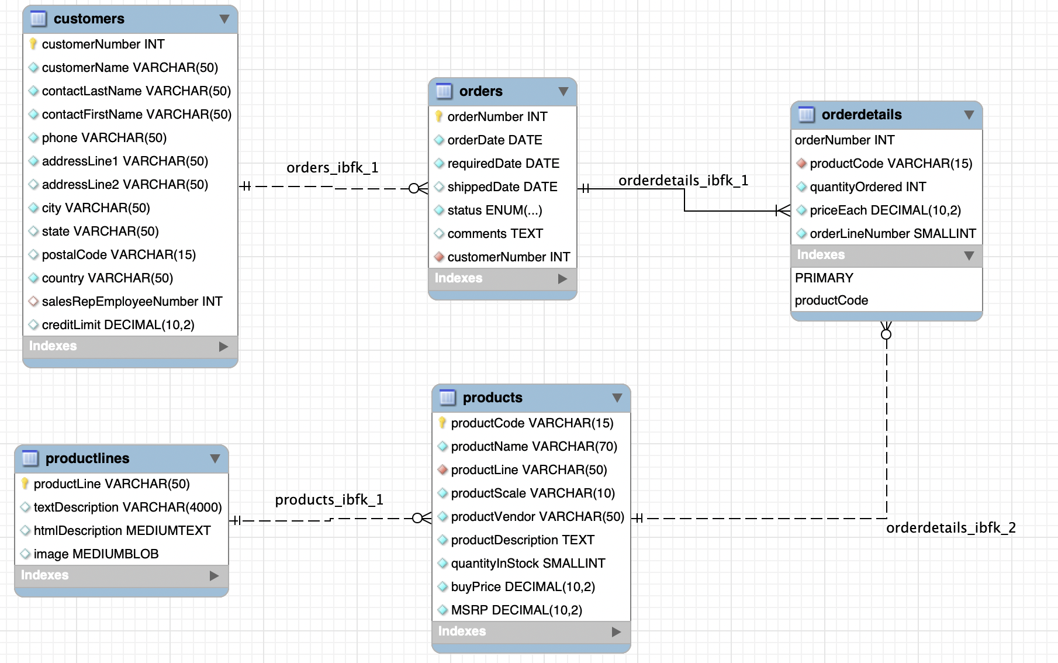
Weak Entity Example: Orders, OrderDetails
https://www.mysqltutorial.org/mysql-sample-database.aspx/
14 | W4111_02_F20: Introduction to Databases – Lecture 6

Slide 15
Inheritance, IsA, Specialization
15 | W4111_02_F20: Introduction to Databases -- Lecture 6

Slide 16
Specialization
Top-down design process; we designate sub-groupings within an entity set that are distinctive from other entities in the set.
These sub-groupings become lower-level entity sets that have attributes or participate in relationships that do not apply to the higher-level entity set.
Depicted by a triangle component labeled ISA (e.g., instructor “is a” person).
Attribute inheritance – a lower-level entity set inherits all the attributes and relationship participation of the higher-level entity set to which it is linked.

Slide 17
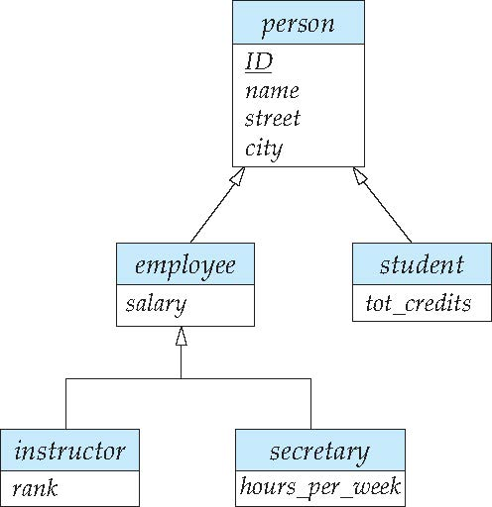
Specialization Example
Overlapping – employee and student
Disjoint – instructor and secretary
Total and partial

Slide 18
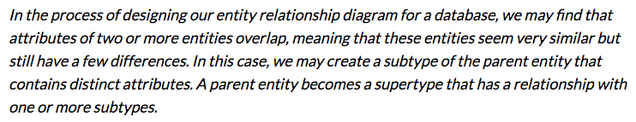
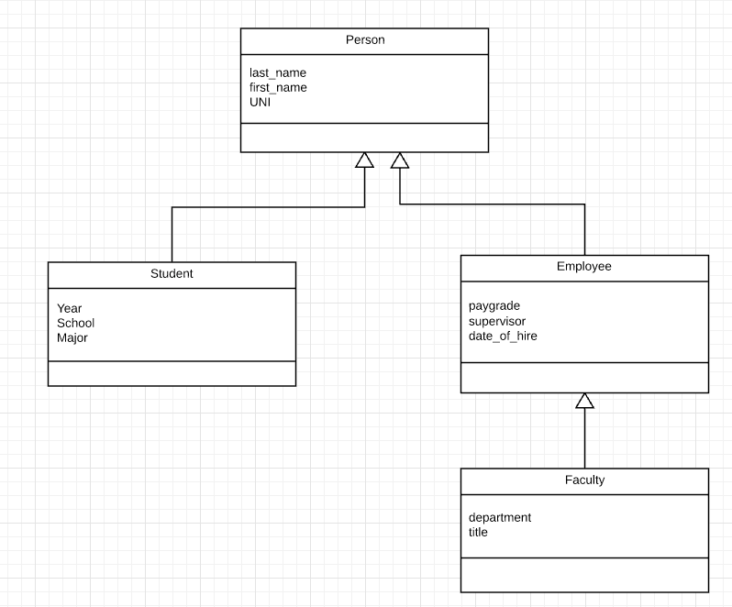
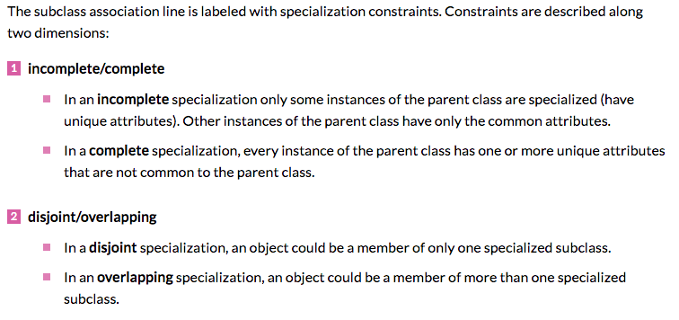
Inheritance, IsA, Specialization
Are all employees faculty?
Can students also be employees?
http://www.vertabelo.com/blog/technical-articles/inheritance-in-a-relational-database
18 | W4111_02_F20: Introduction to Databases – Lecture 6

Slide 19
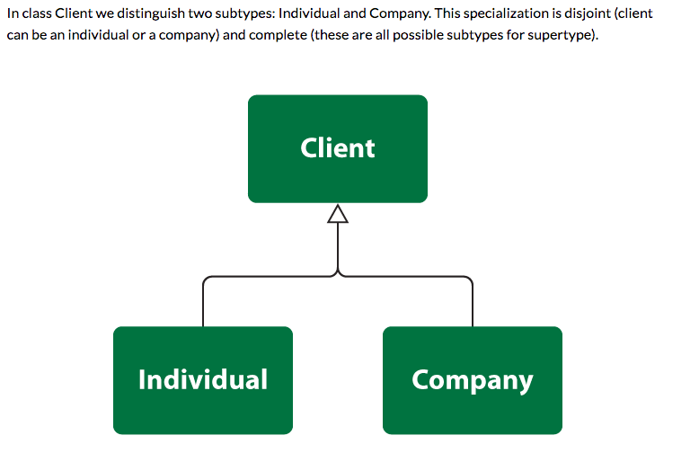
Simpler Example
19 | W4111_02_F20: Introduction to Databases – Lecture 6

Slide 20
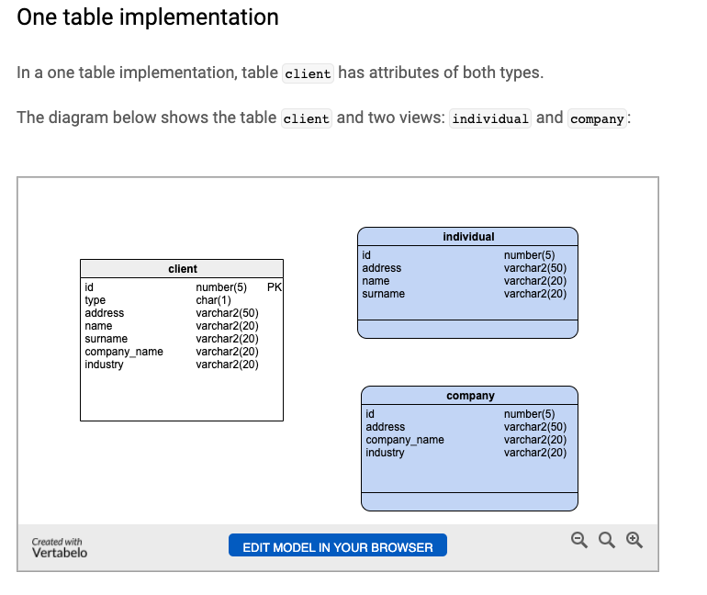
One Table Implementation
Views
Tables
20 | W4111_02_F20: Introduction to Databases – Lecture 6

Slide 21
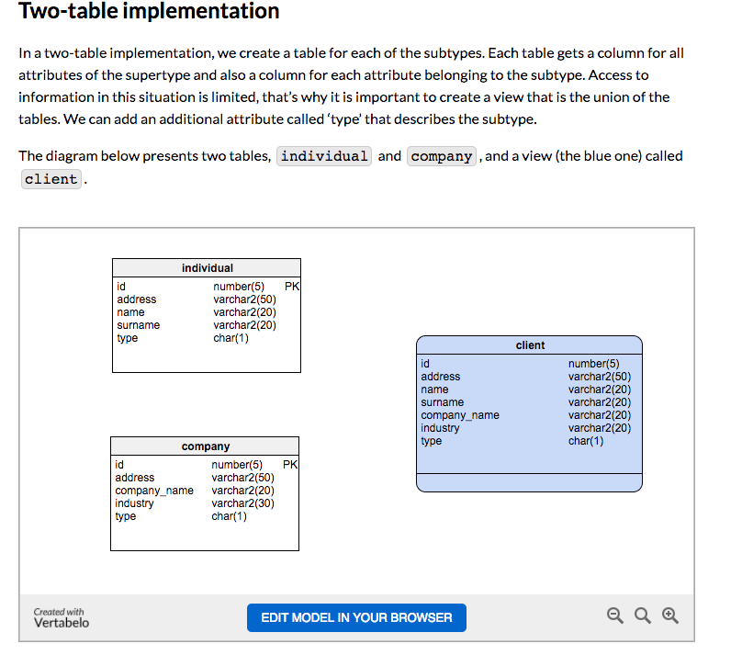
Two Table Implementation
View
Tables
21 | W4111_02_F20: Introduction to Databases – Lecture 6

Slide 22
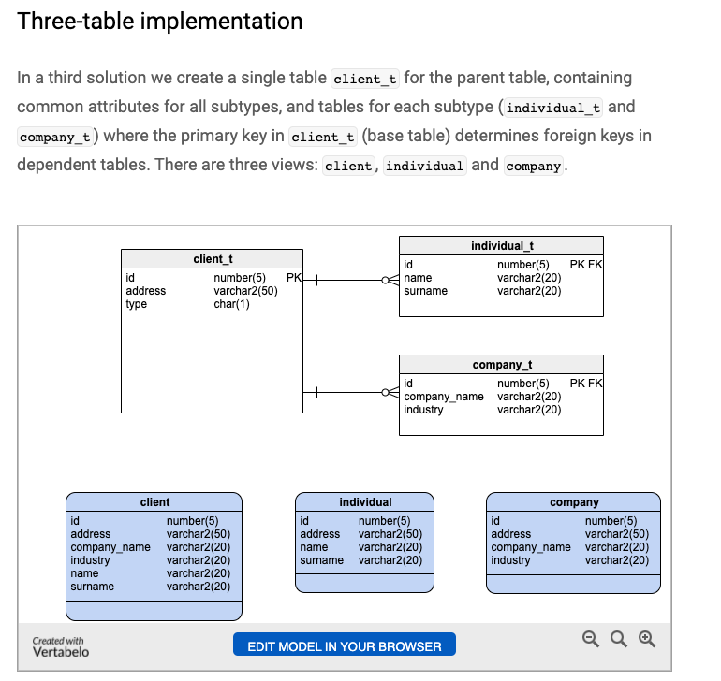
Two Table Implementation
Tables
Views
22 | W4111_02_F20: Introduction to Databases – Lecture 6

Slide 23
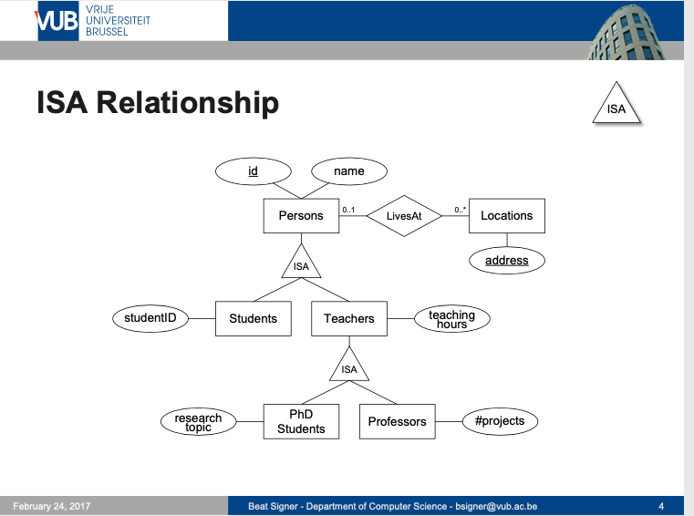
Modeling
23 | W4111_02_F20: Introduction to Databases – Lecture 6

Slide 24
ER vs. UML Class Diagrams
ER Diagram Notation
Equivalent in UML
I use this approach in Crow’s Foot Notation but that is not standard.
* Generalization can use merged or separate arrows independent
of disjoint/overlapping

Slide 25
Redundant Attributes
25 | W4111_02_F20: Introduction to Databases -- Lecture 7

Slide 26
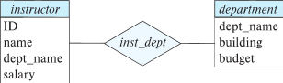
Redundant Attributes
Suppose we have entity sets:
instructor, with attributes: ID, name, dept_name, salary
department, with attributes: dept_name, building, budget
We model the fact that each instructor has an associated department using a relationship set inst_dept
The attribute dept_name in instructor replicates information present in the relationship and is therefore redundant
and needs to be removed.
BUT: when converting back to tables, in some cases the attribute gets reintroduced, as we will see later.

Slide 27
Design Alternatives
In designing a database schema, we must ensure that we avoid two major pitfalls:
Redundancy: a bad design may result in repeat information.
Redundant representation of information may lead to data inconsistency among the various copies of information
Incompleteness: a bad design may make certain aspects of the enterprise difficult or impossible to model.
Avoiding bad designs is not enough. There may be a large number of good designs from which we must choose.
Emphasis Added
Notes:
27

Slide 28
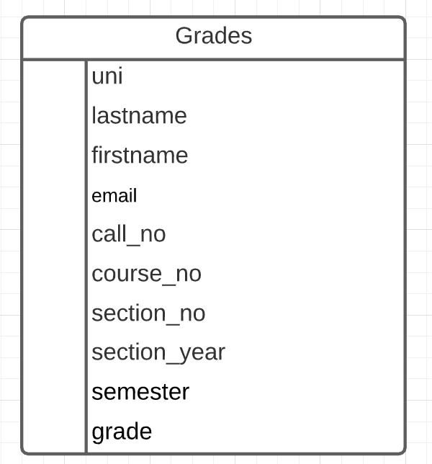
Redundant Information Example
Consider the Grades table/relation:
Uni identifies student.
lastname, firstname, email have obvious meaning.
call_no, course_no, section_no, semester, section_year, grade have the obvious meanings relative to Columbia course info.
Let’s focus on redundant information problems:
Inside the table:
(uni, lastname, firstname, email)
(call_no, course_no, section_no, section_year, semester)
Between tables: Presumable there are other tables with information on
Course descriptions and sections.
Course enrollments.
Additional student information.
This is easier if we make some data and show how we can “break it.”
28 | W4111_02_F20: Introduction to Databases – Lecture 6

Slide 29
Aggregation
29 | W4111_02_F20: Introduction to Databases -- Lecture 7

Slide 30
Aggregation
Consider the ternary relationship proj_guide, which we saw earlier
Suppose we want to record evaluations of a student by a guide on a project

Slide 31
Aggregation (Cont.)
Relationship sets eval_for and proj_guide represent overlapping information
Every eval_for relationship corresponds to a proj_guide relationship
However, some proj_guide relationships may not correspond to any eval_for relationships
So we can’t discard the proj_guide relationship
Eliminate this redundancy via aggregation
Treat relationship as an abstract entity
Allows relationships between relationships
Abstraction of relationship into new entity

Slide 32
Aggregation (Cont.)
Eliminate this redundancy via aggregation without introducing redundancy, the following diagram represents:
A student is guided by a particular instructor on a particular project
A student, instructor, project combination may have an associated evaluation
Notes:
32

Slide 33
Reduction to Relational Schemas
To represent aggregation, create a schema containing
Primary key of the aggregated relationship,
The primary key of the associated entity set
Any descriptive attributes
In our example:
The schema eval_for is:
eval_for (s_ID, project_id, i_ID, evaluation_id)
The schema proj_guide is redundant.

Slide 34
Some Mistakes and Patterns
34 | W4111_02_F20: Introduction to Databases -- Lecture 7

Slide 35
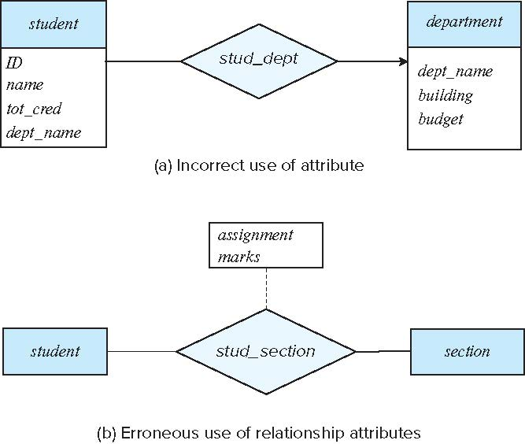
Common Mistakes in E-R Diagrams
Example of erroneous E-R diagrams
Notes:
35

Slide 36
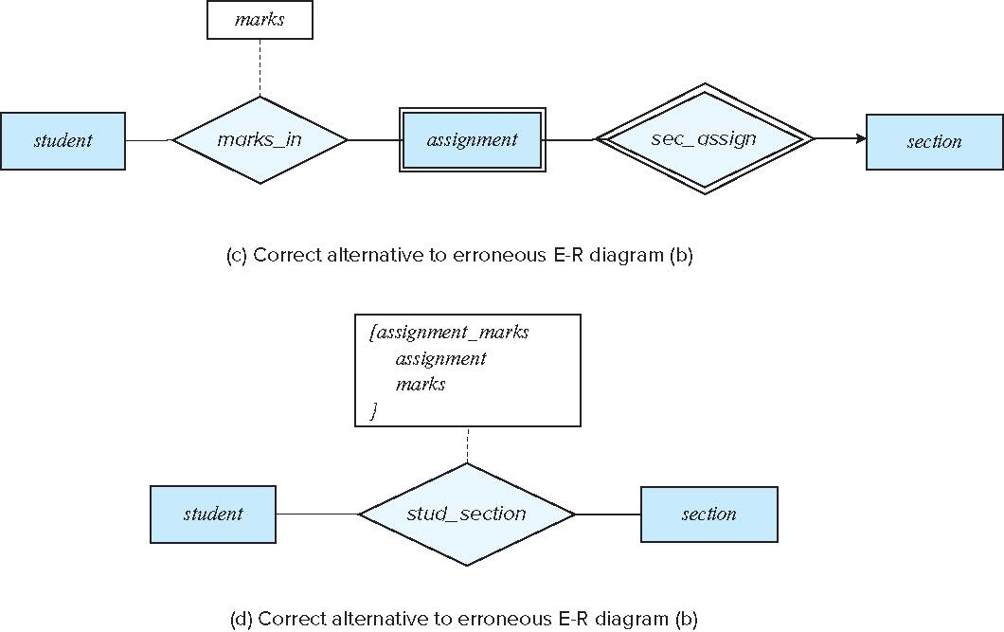
Common Mistakes in E-R Diagrams (Cont.)
Correct versions of the E-R diagram of previous slide
Notes:
36

Slide 37
Entities vs. Attributes
Use of entity sets vs. attributes
Use of phone as an entity allows extra information about phone numbers (plus multiple phone numbers)
Notes:
37

Slide 38
Entities vs. Relationship sets
Use of entity sets vs. relationship sets
Possible guideline is to designate a relationship set to describe
an action that occurs between entities
Placement of relationship attributes
For example, attribute date as attribute of advisor or as attribute of student
Notes:
38

Slide 39
Binary Vs. Non-Binary Relationships
Although it is possible to replace any non-binary (n-ary, for n > 2) relationship set by a number of distinct binary relationship sets, a n-ary relationship set shows more clearly that several entities participate in a single relationship.
Some relationships that appear to be non-binary may be better represented using binary relationships
For example, a ternary relationship parents, relating a child to his/her father and mother, is best replaced by two binary relationships, father and mother
Using two binary relationships allows partial information (e.g., only mother being known)
But there are some relationships that are naturally non-binary
Example: proj_guide
Notes:
39

Slide 40
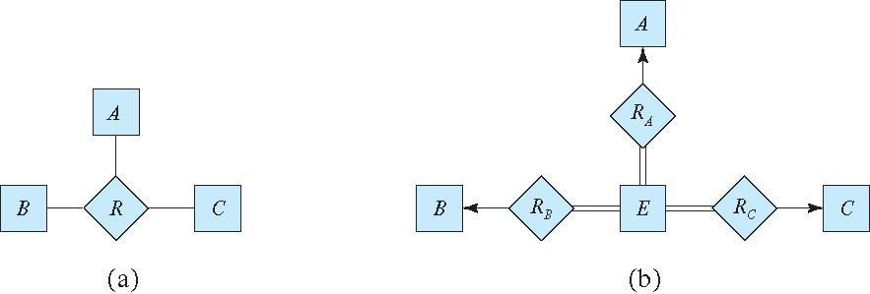
Converting Non-Binary Relationships to Binary Form
In general, any non-binary relationship can be represented using binary relationships by creating an artificial entity set.
Replace R between entity sets A, B and C by an entity set E, and three relationship sets:
1. R_{A}, relating E and A 2. R_{B}, relating E and B 3. R_{C}, relating E and C
Create an identifying attribute for E and add any attributes of R to E
For each relationship (a_{i} , b_{i} , c_{i}) in R, create
1. a new entity e_{i} in the entity set E 2. add (e_{i} , a_{i} ) to R_{A}
3. add (e_{i} , b_{i} ) to R_{B} 4. add (e_{i} , c_{i} ) to R_{C}
Notes:
40

Slide 41
Converting Non-Binary Relationships (Cont.)
Also need to translate constraints
Translating all constraints may not be possible
There may be instances in the translated schema that cannot correspond to any instance of R
Exercise: add constraints to the relationships R_{A}, R_{B} and R_{C} to ensure that a newly created entity corresponds to exactly one entity in each of entity sets A, B and C
We can avoid creating an identifying attribute by making E a weak entity set (described shortly) identified by the three relationship sets
Notes:
41

Slide 42
E-R Design Decisions
The use of an attribute or entity set to represent an object.
Whether a real-world concept is best expressed by an entity set or a relationship set.
The use of a ternary relationship versus a pair of binary relationships.
The use of a strong or weak entity set.
The use of specialization/generalization – contributes to modularity in the design.
The use of aggregation – can treat the aggregate entity set as a single unit without concern for the details of its internal structure.

Slide 43
Web Applications Access Databases
43 | W4111_02_F20: Introduction to Databases -- Lecture 7
Notes:
bb

Slide 44
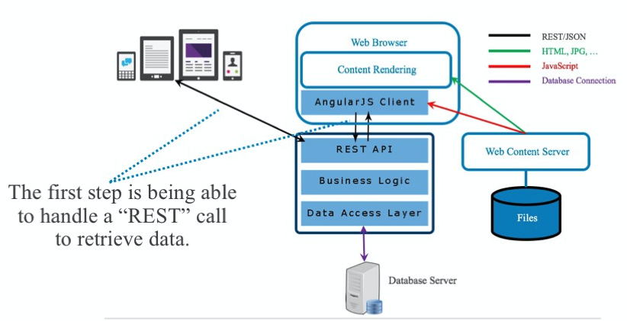
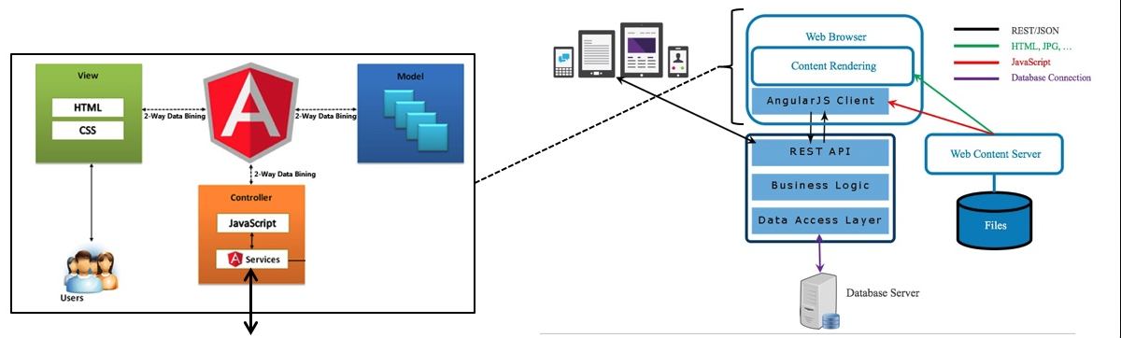
Web Application Structure
Client produces what the user sees.
Based on some kind of markup language/templates.
Data returned from REST API calls.
Web server – returns static content.
Web application:
Implements application logic.
Queries database using SQL.
DB Server: SQL statements and response
There are many frameworks
Angular 2-9.
React.
... ...
Client/browser application models
Model-View-Controller
View-Model-Viewmodel
... ...
44 | W4111_02_F20: Introduction to Databases – Lecture 7

Slide 45
SQL Injection
Suppose query is constructed using
"select * from instructor where name = '" + name + "'"
Suppose the user, instead of entering a name, enters:
X' or 'Y' = 'Y
then the resulting statement becomes:
"select * from instructor where name = '" + "X' or 'Y' = 'Y" + "'"
which is:
select * from instructor where name = 'X' or 'Y' = 'Y'
User could have even used
X'; update instructor set salary = salary + 10000; --
Prepared stament internally uses: "select * from instructor where name = 'X\' or \'Y\' = \'Y'
Always use prepared statements, with user inputs as parameters

Slide 46
Embedded SQL
The SQL standard defines embeddings of SQL in a variety of programming languages such as C, C++, Java, Fortran, and PL/1,
A language to which SQL queries are embedded is referred to as a host language, and the SQL structures permitted in the host language comprise embedded SQL.
The basic form of these languages follows that of the System R embedding of SQL into PL/1.
EXEC SQL statement is used in the host language to identify embedded SQL request to the preprocessor
EXEC SQL <embedded SQL statement >;
Note: this varies by language:
In some languages, like COBOL, the semicolon is replaced with END-EXEC
In Java embedding uses # SQL { …. };
DFF Comments:
Do not worry about this. I will not ask query or programming questions.
You should be aware. I may ask a short written question.

Slide 47
Database Connections and Cursors
“A Database connection is a facility in computer science that allows client software to talk to database server software, whether on the same machine or not. A connection is required to send commands and receive answers, usually in the form of a result set. Connections are built by supplying an underlying driver or provider with a connection string, which is a way of addressing a specific database or server and instance as well as user authentication credentials (for example, Server=sql_box;Database=Common;User ID=uid;Pwd=password;). Once a connection has been built it can be opened and closed at will, and properties (such as the command time-out length, or transaction, if one exists) can be set. The Connection String is composed of a set of key/value pairs as dictated by the data access interface and data provider being used.”
“A database cursor can be thought of as a pointer to a specific row within a query result. The pointer can be moved from one row to the next. Depending on the type of cursor, you may be even able to move it to the previous row.”
47 | W4111_02_F20: Introduction to Databases – Lecture 7

Slide 48
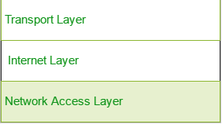
Database Connections
“Client” App 1
Connection
DDL Statement
All database API calls (statements) flow between the client and server on a database connection.
“Client” App 2
Database
Management
System
(Instance)
“Client” App …
DML Statement
A Data Definition Statement Defines or “Creates” a definition/type of data, which is needed for DML.
A Data Manipulation Statement Creates, Retrieves, Updates or Deletes Data.
Application SW
DBMS SW
Database Connection SW
Database Connection SW
48 | W4111_02_F20: Introduction to Databases – Lecture 7

Slide 49
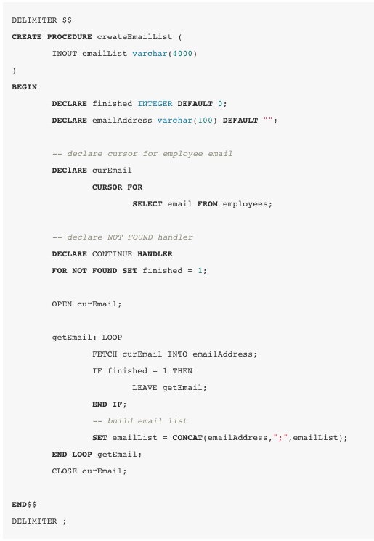
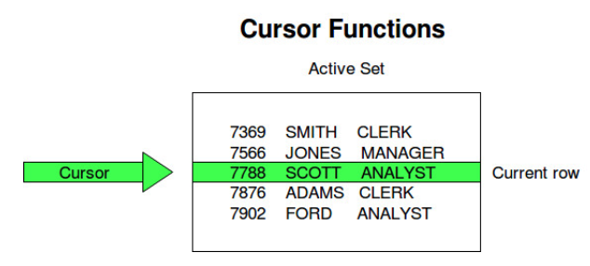
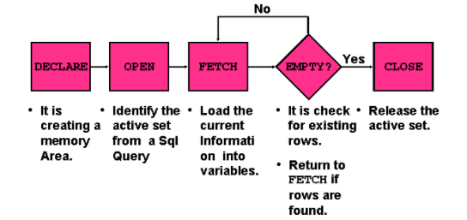
Database Cursors
49 | W4111_02_F20: Introduction to Databases – Lecture 7

Slide 50
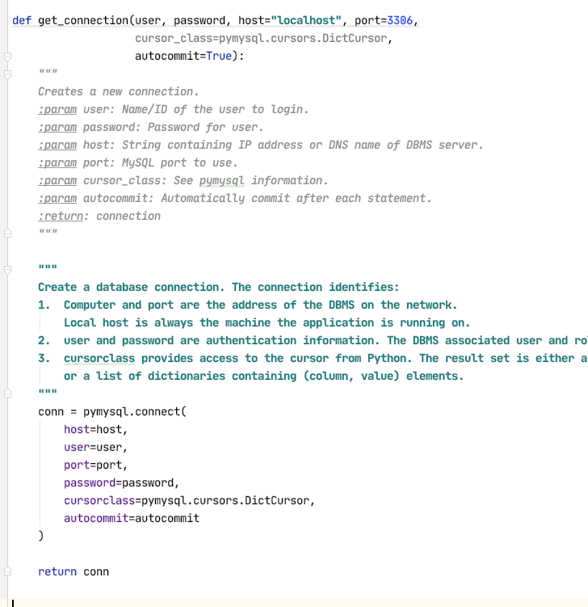
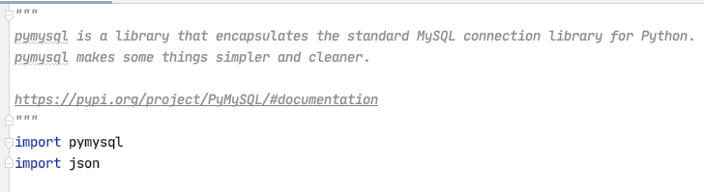
Database Cursors
50 | W4111_02_F20: Introduction to Databases – Lecture 7

Slide 51
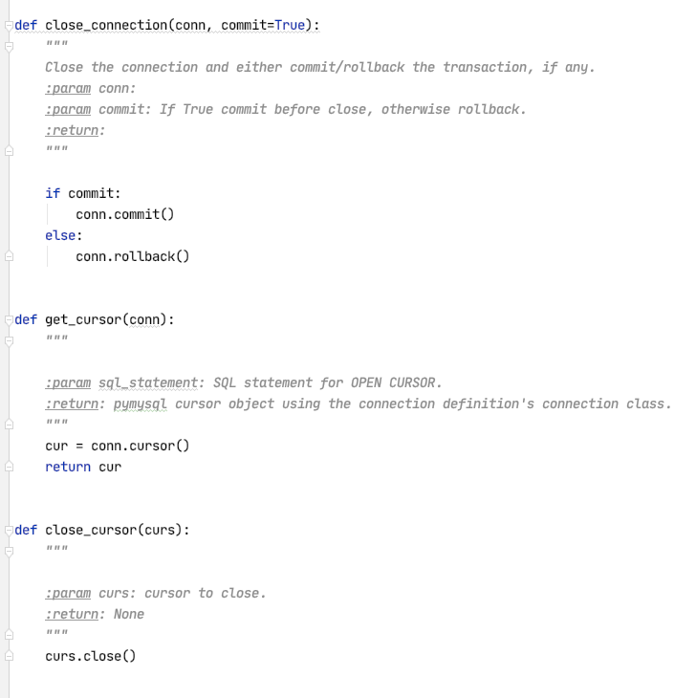
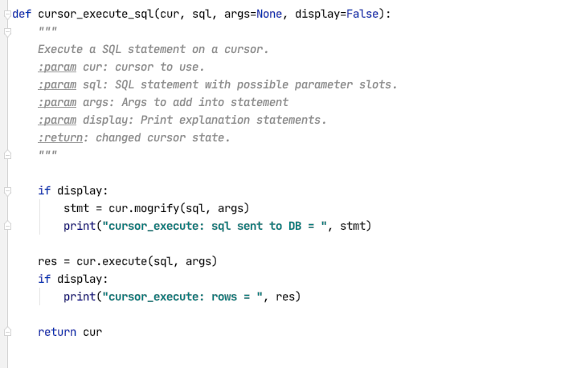
Database Cursors
51 | W4111_02_F20: Introduction to Databases – Lecture 7

Slide 52
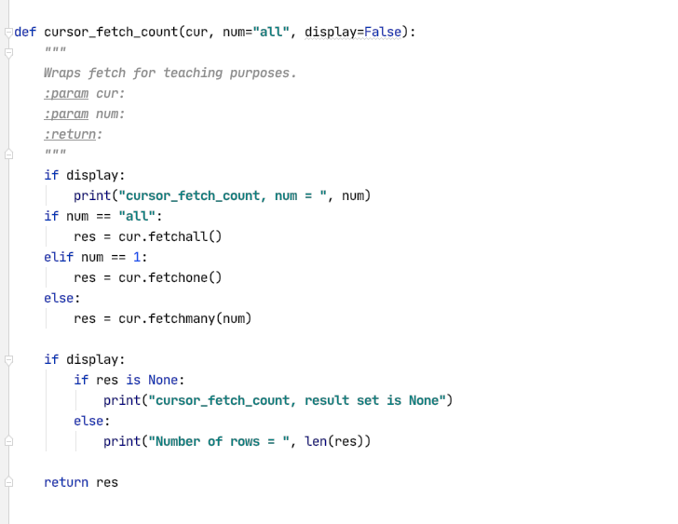
Database Cursors
52 | W4111_02_F20: Introduction to Databases – Lecture 7

Slide 53
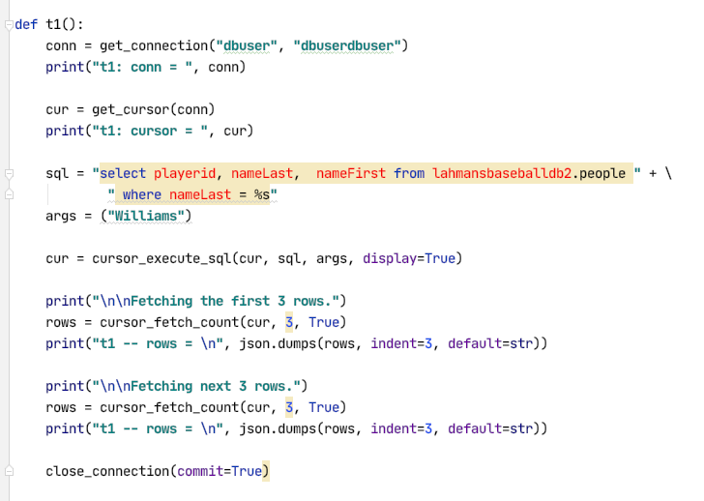
Database Cursors
53 | W4111_02_F20: Introduction to Databases – Lecture 7

Slide 54
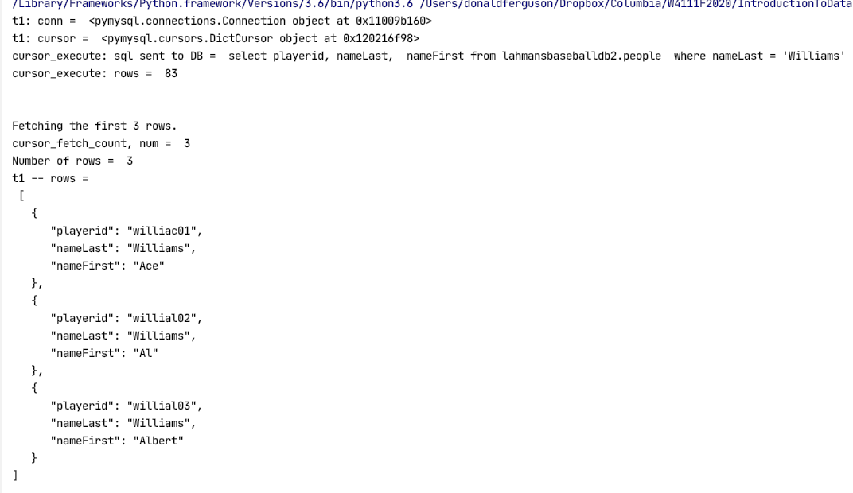
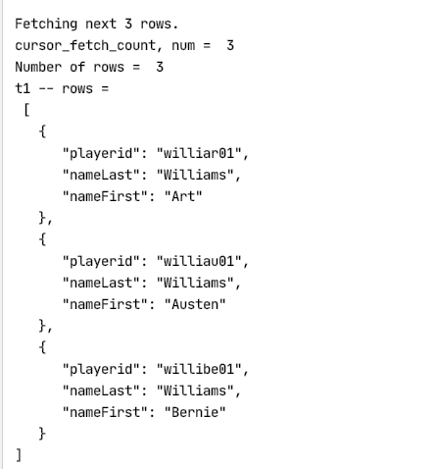
Database Cursors
54 | W4111_02_F20: Introduction to Databases – Lecture 7

Slide 55
Web Application Demo and Walkthrough
55 | W4111_02_F20: Introduction to Databases – Lecture 7

Slide 56
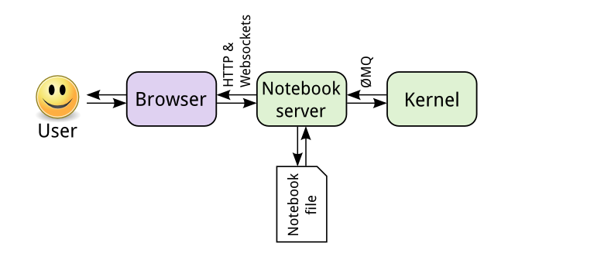

Jupyter Notebook Architecture
https://jupyter.readthedocs.io/en/latest/projects/architecture/content-architecture.html
Operating System Processes
56 | W4111_02_F20: Introduction to Databases – Lecture 7

Slide 57
Worked Examples, Pulling Together the Pieces
57 | W4111_02_F20: Introduction to Databases -- Lecture 7
Notes:
bb

Slide 58
“Inheritance”
58 | W4111_02_F20: Introduction to Databases -- Lecture 5

Slide 59
Inheritance – Putting Some Pieces Together
We will
Model Person, Faculty, Student.
Implement using a two-table solution.
Use a function to generate UNIs.
Integrity
Use
View
Constraints
Security
Stored Procedure
Triggers
To implement integrity.
59 | W4111_02_F20: Introduction to Databases – Lecture 6

Slide 60
“People and Addresses”
60 | W4111_02_F20: Introduction to Databases -- Lecture 5

Slide 61
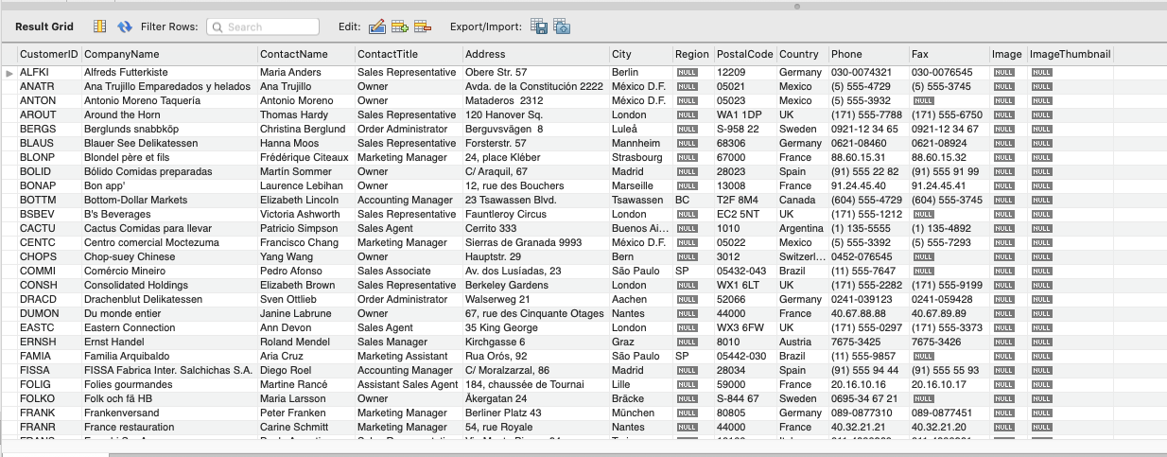
Cleaning Up Addresses (and other Stuff)
https://github.com/dalers/mywind
So much bad, all in just one table. Super excited to see the other ones!
61 | W4111_02_F20: Introduction to Databases – Lecture 6

